Slide 1
CSDS 451: Designing High Performant Systems for AI
Lecture 18
10/30/2025
Sanmukh Kuppannagari
sanmukh.kuppannagari@case.edu
https://sanmukh.research.st/
Case Western Reserve University

Slide 2
Outline
Accelerating Sparse Transformers – Part I

Slide 3
Announcements
PA 2 due this Saturday
WA 3 will be out by Saturday

Slide 4
Outline
Accelerating Sparse Transformers – Part I

Slide 5

Attention Mechanism – Fast Facts
Three Key Operations
Operation #1: $Y= QK^{T}$: Product of $Q$ and $K^{T}$
Operation #2: $Z=Softmax(Y)$
Operation #3: $O=ZV$: Product of $Z$ and $V$ matrices
$Q,K^{T}, V, Z$: Dense matrices

Slide 6








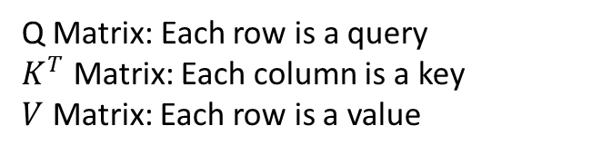










Attention
$$Attention(Q,K,V)$$
$$d_{k}$$
$$d_{v}$$
$$q_{1}$$
$$v_{1}$$
$$q_{2}$$
$$v_{2}$$
$$q_{3}$$
$$v_{3}$$
Softmax
$$L$$
X
$$k_{1}$$
$$k_{2}$$
$$k_{3}$$
$$k_{L}$$
$$d_{k}$$
X
$$L$$
$$q_{L}$$
$$v_{L}$$
$$L$$
Q Matrix: Each row is a query
$K^{T}$ Matrix: Each column is a key
$V$ Matrix: Each row is a value
X: Matrix MM

Slide 7






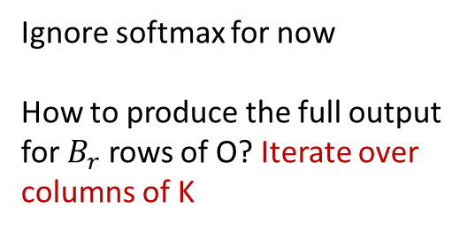






























FlashAttention
$${w_{11}v}_{1}+w_{12}v_{2}+ …+w_{1L}v_{L}$$
$${w_{21}v}_{1}+w_{22}v_{2}+ …+w_{2L}v_{L}$$
$$B_{r}$$
$${w_{31}v}_{1}+w_{32}v_{2}+ …+w_{3L}v_{L}$$
Ignore softmax for now
How to produce the full output for $B_{r}$ rows of O? Iterate over columns of K
$$k_{1}$$
$$k_{2}$$
$$k_{3}$$
$$k_{L}$$
$$L$$
$${w_{L1}v}_{1}+w_{L2}v_{2}+ …+w_{LL}v_{L}$$
$$B_{c}$$
=
$$d_{v}$$
$$q_{1}$$
$$w_{11}$$
$$w_{12}$$
$$w_{13}$$
…
$$w_{1L}$$
$$v_{1}$$
$$q_{2}$$
$$B_{r}$$
$$v_{2}$$
$$B_{c}$$
$$w_{21}$$
…
$$w_{2L}$$
$$v_{3}$$
$$w_{22}$$
$$w_{23}$$
$$L$$
X
$$q_{L}$$
…
$$w_{LL}$$
$$v_{L}$$
$$w_{L1}$$
$$w_{L2}$$
$$w_{L3}$$
Memory Needed: $B_{r}×B_{c}+d_{k}B_{r}+d_{k}B_{c}+d_{v}B_{c}+d_{v}B_{r}$
$$L$$
$$d_{v}$$

Slide 8




FlashAttention
$${w_{11}v}_{1}+w_{12}v_{2}+ …+w_{1L}v_{L}$$
$${w_{21}v}_{1}+w_{22}v_{2}+ …+w_{2L}v_{L}$$
$$B_{r}$$
$${w_{31}v}_{1}+w_{32}v_{2}+ …+w_{3L}v_{L}$$
Ignore softmax for now
How to produce the full output for $B_{r}$ rows of O? Iterate over columns of K
$$k_{1}$$
$$k_{2}$$
$$k_{3}$$
$$k_{L}$$
$$L$$
$${w_{L1}v}_{1}+w_{L2}v_{2}+ …+w_{LL}v_{L}$$
=
$$B_{c}$$
$$d_{v}$$
$$q_{1}$$
$$w_{11}$$
$$w_{12}$$
$$w_{13}$$
…
$$w_{1L}$$
$$v_{1}$$
$$q_{2}$$
$$B_{r}$$
$$v_{2}$$
$$w_{21}$$
…
$$w_{2L}$$
$$v_{3}$$
$$w_{22}$$
$$w_{23}$$
$$L$$
$$B_{c}$$
X
$$q_{L}$$
…
$$w_{LL}$$
$$v_{L}$$
$$w_{L1}$$
$$w_{L2}$$
$$w_{L3}$$
Memory Needed: $B_{r}×B_{c}+d_{k}B_{r}+d_{k}B_{c}+d_{v}B_{c}+d_{v}B_{r}$
$$L$$
$$d_{v}$$

Slide 9




FlashAttention
$${w_{11}v}_{1}+w_{12}v_{2}+ …+w_{1L}v_{L}$$
$${w_{21}v}_{1}+w_{22}v_{2}+ …+w_{2L}v_{L}$$
$$B_{r}$$
$${w_{31}v}_{1}+w_{32}v_{2}+ …+w_{3L}v_{L}$$
Ignore softmax for now
How to produce the full output for $B_{r}$ rows of O? Iterate over columns of K
$$k_{1}$$
$$k_{2}$$
$$k_{3}$$
$$k_{L}$$
$$L$$
$${w_{L1}v}_{1}+w_{L2}v_{2}+ …+w_{LL}v_{L}$$
=
$$B_{c}$$
$$d_{v}$$
$$q_{1}$$
$$w_{11}$$
$$w_{12}$$
$$w_{13}$$
…
$$w_{1L}$$
$$v_{1}$$
$$q_{2}$$
$$B_{r}$$
$$v_{2}$$
$$w_{21}$$
…
$$w_{2L}$$
$$v_{3}$$
$$w_{22}$$
$$w_{23}$$
$$L$$
X
$$q_{L}$$
$$B_{c}$$
…
$$w_{LL}$$
$$v_{L}$$
$$w_{L1}$$
$$w_{L2}$$
$$w_{L3}$$
Memory Needed: $B_{r}×B_{c}+d_{k}B_{r}+d_{k}B_{c}+d_{v}B_{c}+d_{v}B_{r}$
$$L$$
$$d_{v}$$

Slide 10







FlashAttention
$${w_{11}v}_{1}+w_{12}v_{2}+ …+w_{1L}v_{L}$$
$${w_{21}v}_{1}+w_{22}v_{2}+ …+w_{2L}v_{L}$$
$${w_{31}v}_{1}+w_{32}v_{2}+ …+w_{3L}v_{L}$$
Ignore softmax for now
How to produce the full output for $B_{r}$ rows of O? Iterate over columns of K
$$k_{1}$$
$$k_{2}$$
$$k_{3}$$
$$k_{L}$$
$$L$$
$${w_{L1}v}_{1}+w_{L2}v_{2}+ …+w_{LL}v_{L}$$
$$B_{r}$$
$$B_{c}$$
=
$$d_{v}$$
$$q_{1}$$
$$w_{11}$$
$$w_{12}$$
$$w_{13}$$
…
$$w_{1L}$$
$$v_{1}$$
$$q_{2}$$
$$v_{2}$$
$$B_{c}$$
$$w_{21}$$
…
$$w_{2L}$$
$$v_{3}$$
$$w_{22}$$
$$w_{23}$$
$$B_{c}$$
$$L$$
X
$$q_{L}$$
$$B_{r}$$
…
$$w_{LL}$$
$$v_{L}$$
$$w_{L1}$$
$$w_{L2}$$
$$w_{L3}$$
$$L$$
$$d_{v}$$

Slide 11




FlashAttention
$${w_{11}v}_{1}+w_{12}v_{2}+ …+w_{1L}v_{L}$$
$${w_{21}v}_{1}+w_{22}v_{2}+ …+w_{2L}v_{L}$$
$${w_{31}v}_{1}+w_{32}v_{2}+ …+w_{3L}v_{L}$$
Ignore softmax for now
How to produce the full output for $B_{r}$ rows of O? Iterate over columns of K
$$k_{1}$$
$$k_{2}$$
$$k_{3}$$
$$k_{L}$$
$$L$$
$${w_{L1}v}_{1}+w_{L2}v_{2}+ …+w_{LL}v_{L}$$
$$B_{r}$$
=
$$d_{v}$$
$$q_{1}$$
$$w_{11}$$
$$w_{12}$$
$$w_{13}$$
…
$$w_{1L}$$
$$v_{1}$$
$$q_{2}$$
$$v_{2}$$
$$w_{21}$$
…
$$w_{2L}$$
$$v_{3}$$
$$w_{22}$$
$$w_{23}$$
$$B_{c}$$
$$L$$
$$B_{c}$$
X
$$q_{L}$$
$$B_{r}$$
…
$$w_{LL}$$
$$v_{L}$$
$$w_{L1}$$
$$w_{L2}$$
$$w_{L3}$$
$$L$$
$$d_{v}$$

Slide 12




FlashAttention
$${w_{11}v}_{1}+w_{12}v_{2}+ …+w_{1L}v_{L}$$
$${w_{21}v}_{1}+w_{22}v_{2}+ …+w_{2L}v_{L}$$
$${w_{31}v}_{1}+w_{32}v_{2}+ …+w_{3L}v_{L}$$
Ignore softmax for now
How to produce the full output for $B_{r}$ rows of O? Iterate over columns of K
$$k_{1}$$
$$k_{2}$$
$$k_{3}$$
$$k_{L}$$
$$L$$
$${w_{L1}v}_{1}+w_{L2}v_{2}+ …+w_{LL}v_{L}$$
$$B_{r}$$
=
$$d_{v}$$
$$q_{1}$$
$$w_{11}$$
$$w_{12}$$
$$w_{13}$$
…
$$w_{1L}$$
$$v_{1}$$
$$q_{2}$$
$$v_{2}$$
$$w_{21}$$
…
$$w_{2L}$$
$$v_{3}$$
$$w_{22}$$
$$w_{23}$$
$$B_{c}$$
$$L$$
X
$$q_{L}$$
$$B_{r}$$
…
$$w_{LL}$$
$$v_{L}$$
$$B_{c}$$
$$w_{L1}$$
$$w_{L2}$$
$$w_{L3}$$
$$L$$
$$d_{v}$$

Slide 13
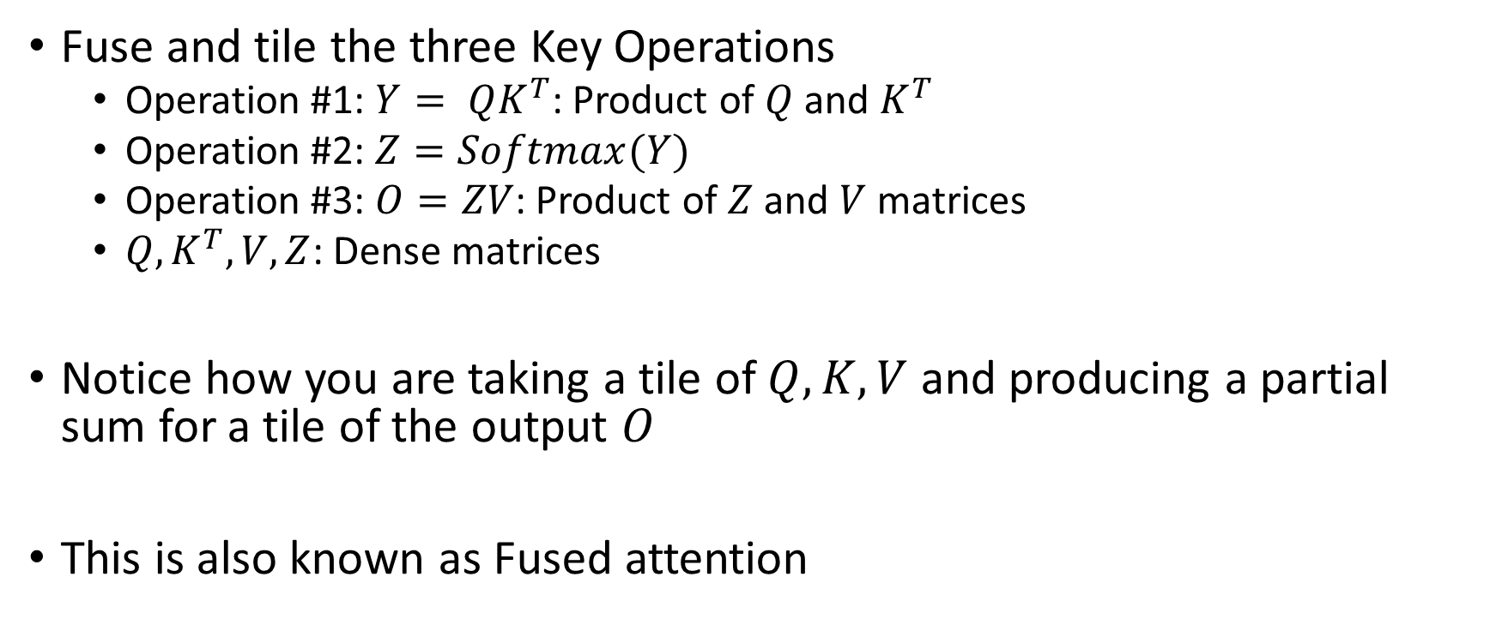
Flash Attention
Fuse and tile the three Key Operations
Operation #1: $Y= QK^{T}$: Product of $Q$ and $K^{T}$
Operation #2: $Z=Softmax(Y)$
Operation #3: $O=ZV$: Product of $Z$ and $V$ matrices
$Q,K^{T}, V, Z$: Dense matrices
Notice how you are taking a tile of $Q, K, V$ and producing a partial sum for a tile of the output $O$
This is also known as Fused attention

Slide 14
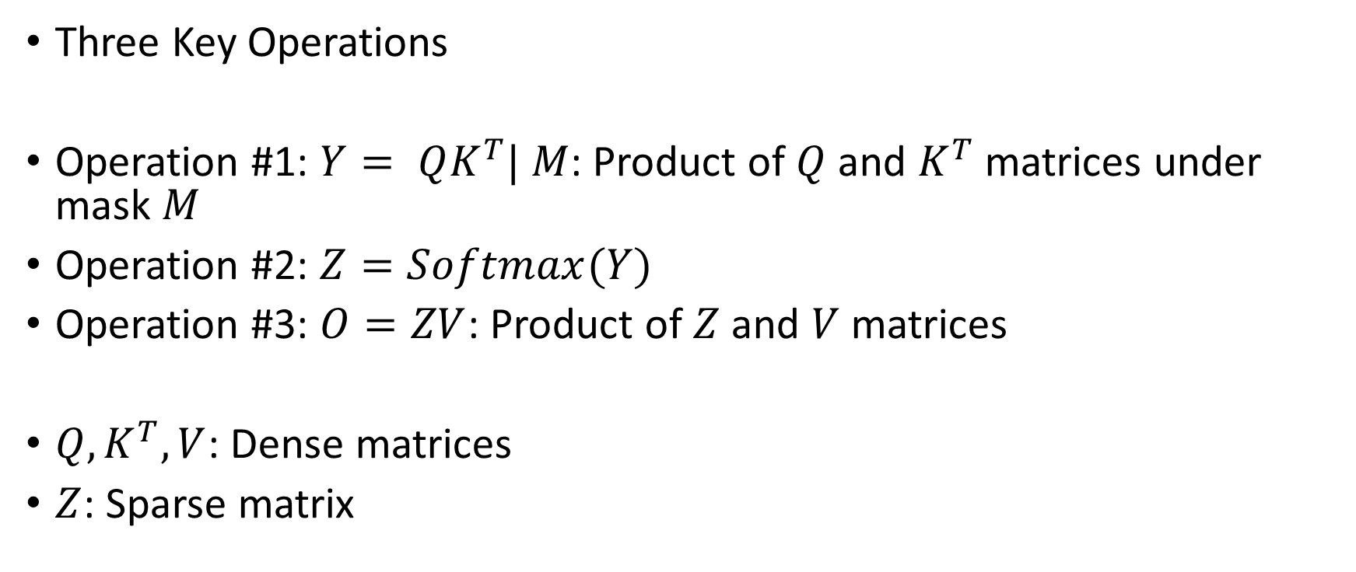
Attention with Sparse Attention Mask
Three Key Operations
Operation #1: $Y= QK^{T}| M$: Product of $Q$ and $K^{T}$ matrices under mask $M$
Operation #2: $Z=Softmax(Y)$
Operation #3: $O=ZV$: Product of $Z$ and $V$ matrices
$Q,K^{T}, V$: Dense matrices
$Z$: Sparse matrix

Slide 15


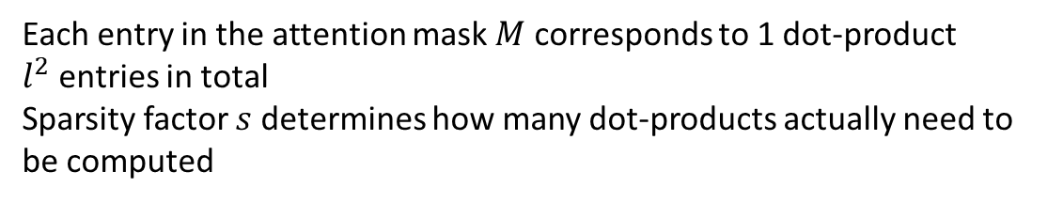

















QK Product with Attention Mask
$$x_{1}$$
$$x_{2}$$
$$x_{3}$$
$$x_{L}$$
$$Q$$
$$K$$
$$x_{1}$$
$$x_{2}$$
$$q_{1}$$
$$x_{3}$$
$$q_{2}$$
$$q_{3}$$
$$L$$
X
$$k_{1}$$
$$k_{2}$$
$$k_{3}$$
$$x_{L}$$
Each entry in the attention mask $M$ corresponds to 1 dot-product
$l^{2}$ entries in total
Sparsity factor $s$ determines how many dot-products actually need to be computed
$$l$$
$$M$$

Slide 16














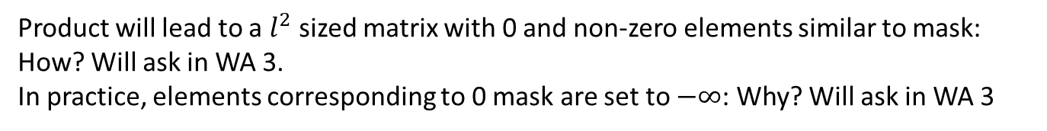



QK Product with Attention Mask
$$Y=QK^{T}$$
$$x_{1}$$
$$x_{2}$$
$$x_{3}$$
$$x_{L}$$
$$x_{1}$$
$$x_{2}$$
$$x_{3}$$
$$x_{L}$$
$$x_{1}$$
$$x_{1}$$
$$x_{2}$$
$$x_{2}$$
$$x_{3}$$
$$x_{3}$$
$$x_{L}$$
$$x_{L}$$
Product will lead to a $l^{2}$ sized matrix with 0 and non-zero elements similar to mask: How? Will ask in WA 3.
In practice, elements corresponding to 0 mask are set to $−∞$: Why? Will ask in WA 3
$$M$$

Slide 17

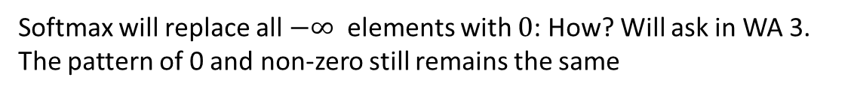
Softmax with Attention Mask
$$Z=softmax(QK^{T})$$
$$x_{1}$$
$$x_{2}$$
$$x_{3}$$
$$x_{L}$$
$$x_{1}$$
$$x_{2}$$
$$x_{3}$$
$$x_{L}$$
$$x_{1}$$
$$x_{1}$$
$$x_{2}$$
$$x_{2}$$
$$x_{3}$$
$$x_{3}$$
$$x_{L}$$
$$x_{L}$$
Softmax will replace all $−∞$ elements with $0$: How? Will ask in WA 3.
The pattern of 0 and non-zero still remains the same
$$M$$

Slide 18















Product with V Matrix
$$x_{1}$$
$$x_{2}$$
$$x_{3}$$
$$x_{L}$$
$$x_{1}$$
$$d_{v}$$
$$x_{2}$$
$$v_{1}$$
$$x_{3}$$
$$v_{2}$$
$$v_{3}$$
$$L$$
$$x_{L}$$
$$Z=softmax(QK^{T})$$
$$V$$
Product of a sparse matrix ($Z=softmax(QK^{T})$) and dense $V$ matrix

Slide 19
Attention with Sparse Attention Mask
Three Key Operations
Operation #1: $Y= QK^{T}| M$: Product of $Q$ and $K^{T}$ matrices under mask $M$
Operation #2: $Z=Softmax(Y)$
Operation #3: $O=ZV$: Product of $Z$ and $V$ matrices
$Q,K^{T}, V$: Dense matrices
$Z$: Sparse matrix

Slide 20
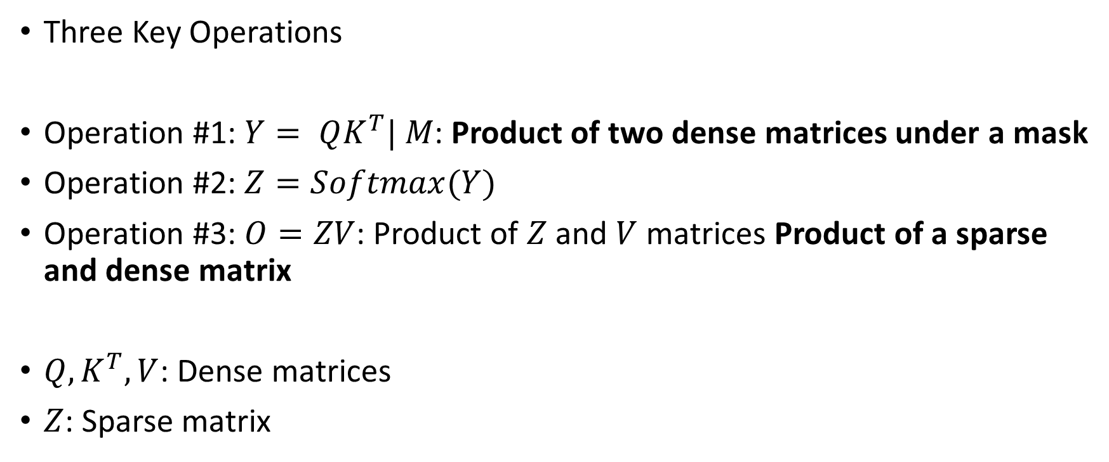
Attention with Sparse Attention Mask
Three Key Operations
Operation #1: $Y= QK^{T}| M$: Product of two dense matrices under a mask
Operation #2: $Z=Softmax(Y)$
Operation #3: $O=ZV$: Product of $Z$ and $V$ matrices Product of a sparse and dense matrix
$Q,K^{T}, V$: Dense matrices
$Z$: Sparse matrix

Slide 21
Attention with Sparse Attention Mask
Three Key Operations
Operation #1: $Y= QK^{T}| M$: Product of two dense matrices under a mask
Operation #2: $Z=Softmax(Y)$
Operation #3: $O=ZV$: Product of $Z$ and $V$ matrices Product of a sparse and dense matrix
$Q,K^{T}, V$: Dense matrices
$Z$: Sparse matrix

Slide 22
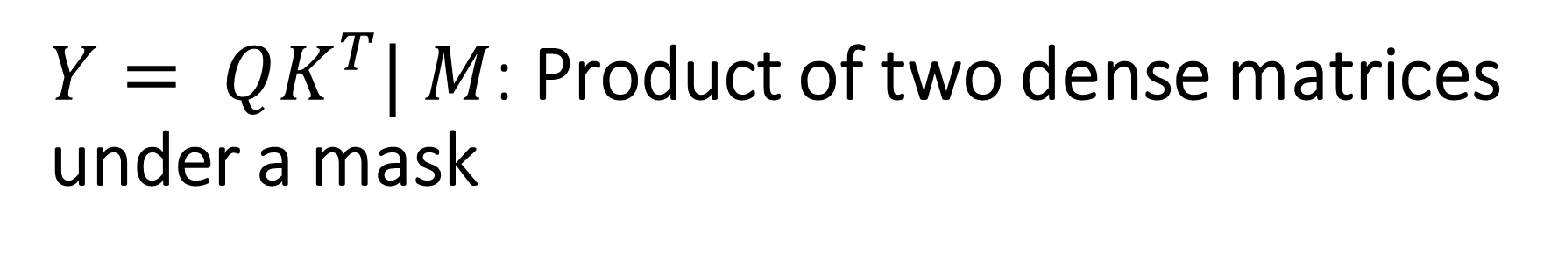
$Y= QK^{T}| M$: Product of two dense matrices under a mask
Known as Sampled Dense Dense Matrix Multiplication
Just a handful of papers on accelerating this kernel – we will discuss in next class

Slide 23
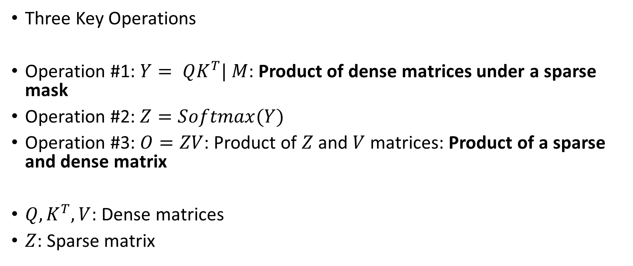
Attention with Sparse Attention Mask
Three Key Operations
Operation #1: $Y= QK^{T}| M$: Product of dense matrices under a sparse mask
Operation #2: $Z=Softmax(Y)$
Operation #3: $O=ZV$: Product of $Z$ and $V$ matrices: Product of a sparse and dense matrix
$Q,K^{T}, V$: Dense matrices
$Z$: Sparse matrix

Slide 24
Sparse-Dense Matrix Multiplication (SpMM)
An important kernel in scientific computing
In machine learning, an important kernel in Graph Neural Networks (GNNs), pruned CNNs, and Sparse Transformers
Extensive Research has been performed (and still continuing) on accelerating SpMM

Slide 25





Sparse Dense Matrix Multiplication (SpMM)
$$L$$
$$x_{1}$$
$$x_{2}$$
$$x_{3}$$
$$x_{L}$$
$$x_{1}$$
$$d_{v}$$
$$x_{2}$$
$$v_{1}$$
$$x_{3}$$
$$v_{2}$$
$$v_{3}$$
$$L$$
$$L$$
$$v_{L}$$
$$x_{L}$$
$$Z$$
$$V$$
Product of a sparse matrix ($Z=softmax(QK^{T})$) and dense $V$ matrix

Slide 26

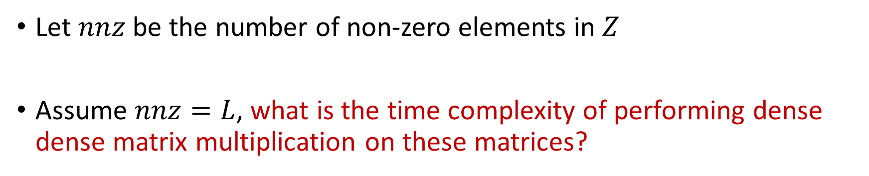



Sparse Dense Matrix Multiplication (SpMM)
Let $nnz$ be the number of non-zero elements in $Z$
Assume $nnz=L$, what is the time complexity of performing dense dense matrix multiplication on these matrices?
$$L$$
$$d_{v}$$
$$L$$
X
$$L$$
Z
V

Slide 27
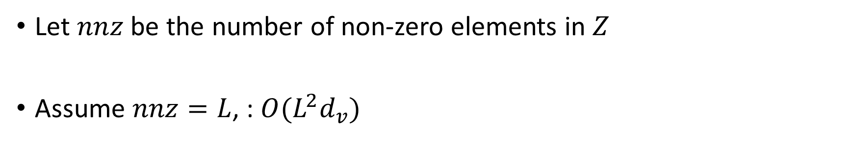
Sparse Dense Matrix Multiplication (SpMM)
Let $nnz$ be the number of non-zero elements in $Z$
Assume $nnz=L$, : $O(L^{2}d_{v})$
$$L$$
$$d_{v}$$
$$L$$
X
$$L$$
Z
V

Slide 28
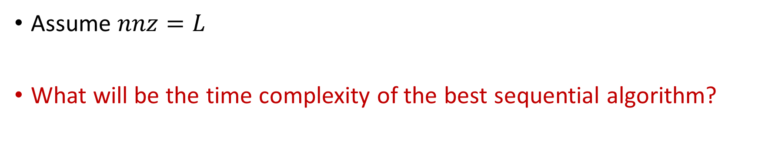
Sparse Dense Matrix Multiplication (SpMM)
Assume $nnz=L$
What will be the time complexity of the best sequential algorithm?
$$L$$
$$d_{v}$$
$$L$$
X
$$L$$
Z
V

Slide 29
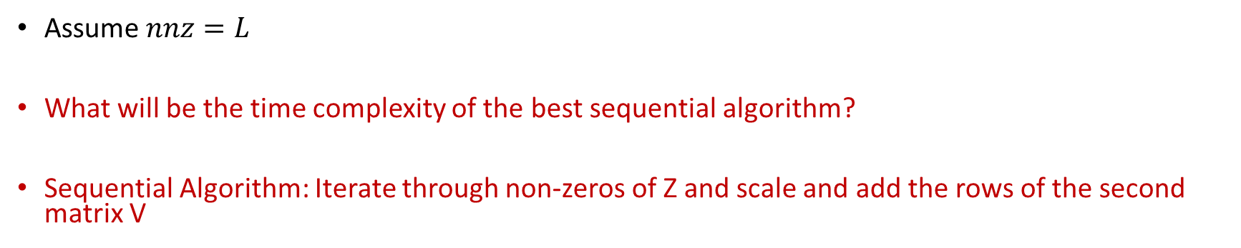
Sparse Dense Matrix Multiplication (SpMM)
Assume $nnz=L$
What will be the time complexity of the best sequential algorithm?
Sequential Algorithm: Iterate through non-zeros of Z and scale and add the rows of the second matrix V
$$L$$
$$d_{v}$$
$$L$$
X
$$L$$
Z
V

Slide 30






Sparse Dense Matrix Multiplication (SpMM)
0
2
0
$$a_{1}$$
$$a_{2}$$
1
2
0
X
$$b_{1}$$
$$b_{2}$$
=
??
0
3
5
$$c_{1}$$
$$c_{2}$$

Slide 31


Sparse Dense Matrix Multiplication (SpMM)
0
2
0
$$a_{1}$$
$$a_{2}$$
$${2b}_{1}$$
$${2b}_{2}$$
1
2
0
X
$$b_{1}$$
$$b_{2}$$
=
0
3
5
$$c_{1}$$
$$c_{2}$$

Slide 32



Sparse Dense Matrix Multiplication (SpMM)
0
2
0
$$a_{1}$$
$$a_{2}$$
$${2b}_{1}$$
$${2b}_{2}$$
1
2
0
X
$$b_{1}$$
$$b_{2}$$
=
$${a_{1}+2b}_{1}$$
$${a_{2}+ 2b}_{2}$$
0
3
5
$$c_{1}$$
$$c_{2}$$

Slide 33




Sparse Dense Matrix Multiplication (SpMM)
0
2
0
$$a_{1}$$
$$a_{2}$$
$${2b}_{1}$$
$${2b}_{2}$$
1
2
0
X
$$b_{1}$$
$$b_{2}$$
=
$${a_{1}+2b}_{1}$$
$${a_{2}+ 2b}_{2}$$
0
3
5
$$c_{1}$$
$$c_{2}$$
$${{3b}_{1}+5c}_{1}$$
$${3b_{2}+5c}_{2}$$

Slide 34
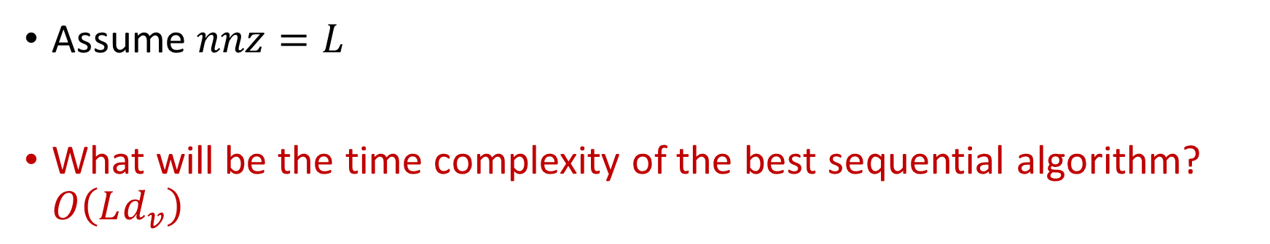
Sparse Dense Matrix Multiplication (SpMM)
Assume $nnz=L$
What will be the time complexity of the best sequential algorithm? $O\left(Ld_{v}\right)$
$$L$$
$$d_{v}$$
$$L$$
X
$$L$$
Z
V

Slide 35
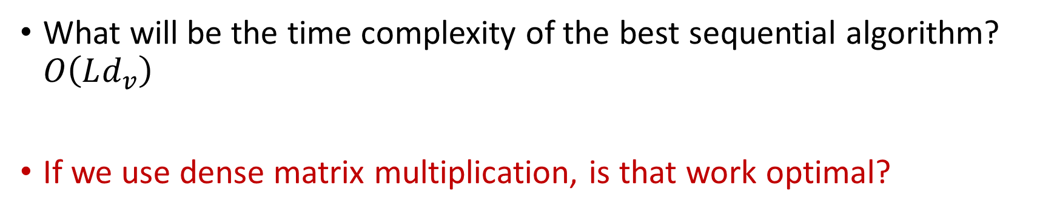
Sparse Dense Matrix Multiplication (SpMM)
What will be the time complexity of the best sequential algorithm? $O\left(Ld_{v}\right)$
If we use dense matrix multiplication, is that work optimal?
$$L$$
$$d_{v}$$
$$L$$
X
$$L$$
Z
V

Slide 36
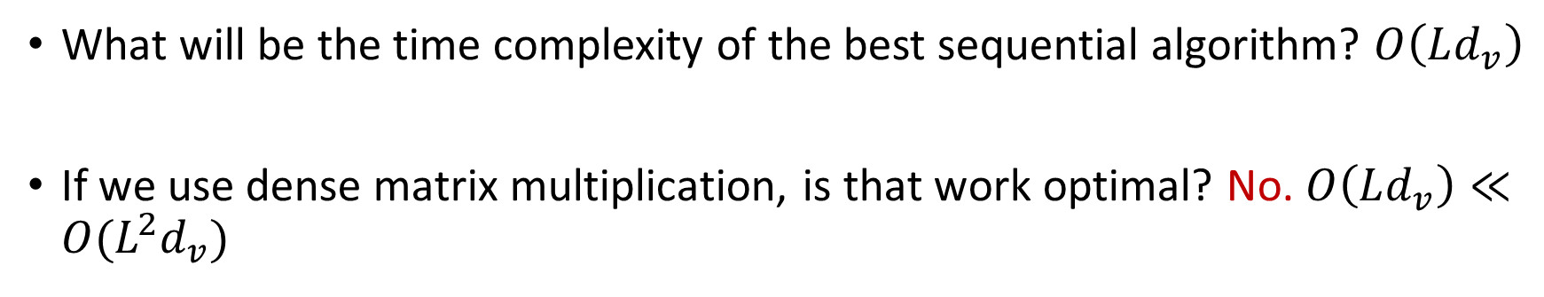
Sparse Dense Matrix Multiplication (SpMM)
What will be the time complexity of the best sequential algorithm? $O\left(Ld_{v}\right)$
If we use dense matrix multiplication, is that work optimal? No. $O\left(Ld_{v}\right)≪O(L^{2}d_{v})$
$$L$$
$$d_{v}$$
$$L$$
X
$$L$$
Z
V

Slide 37
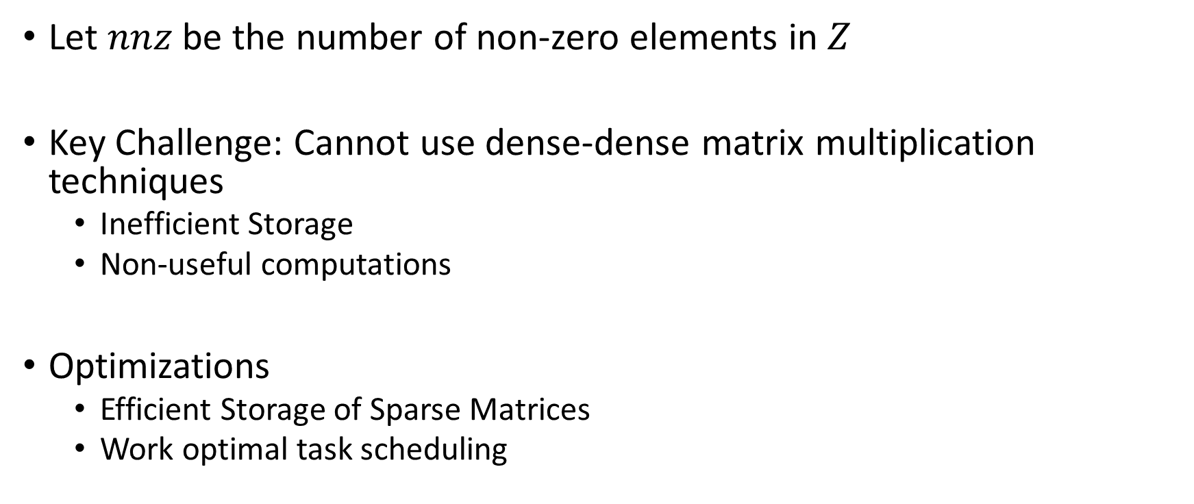
Sparse Dense Matrix Multiplication (SpMM)
Let $nnz$ be the number of non-zero elements in $Z$
Key Challenge: Cannot use dense-dense matrix multiplication techniques
Inefficient Storage
Non-useful computations
Optimizations
Efficient Storage of Sparse Matrices
Work optimal task scheduling

Slide 38
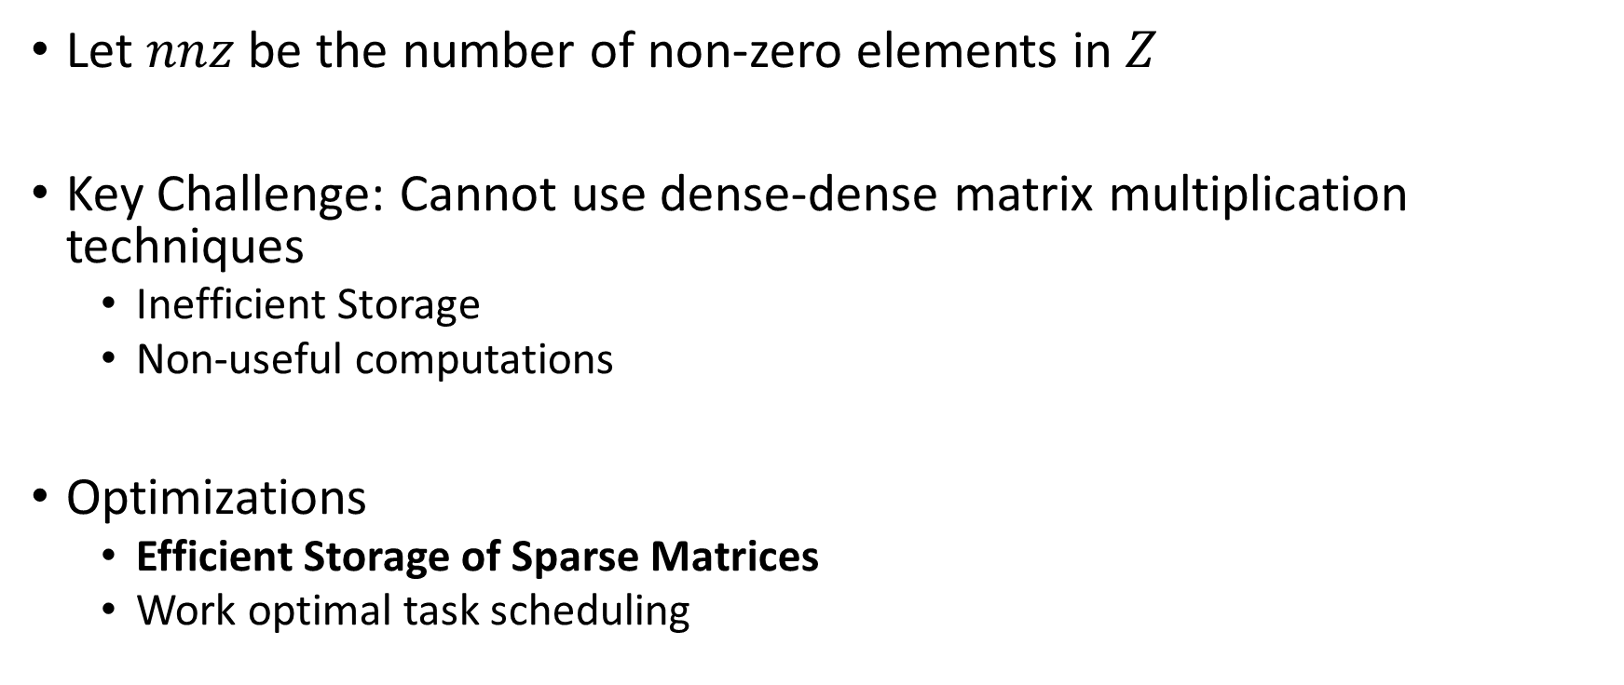
Sparse Dense Matrix Multiplication (SpMM)
Let $nnz$ be the number of non-zero elements in $Z$
Key Challenge: Cannot use dense-dense matrix multiplication techniques
Inefficient Storage
Non-useful computations
Optimizations
Efficient Storage of Sparse Matrices
Work optimal task scheduling

Slide 39
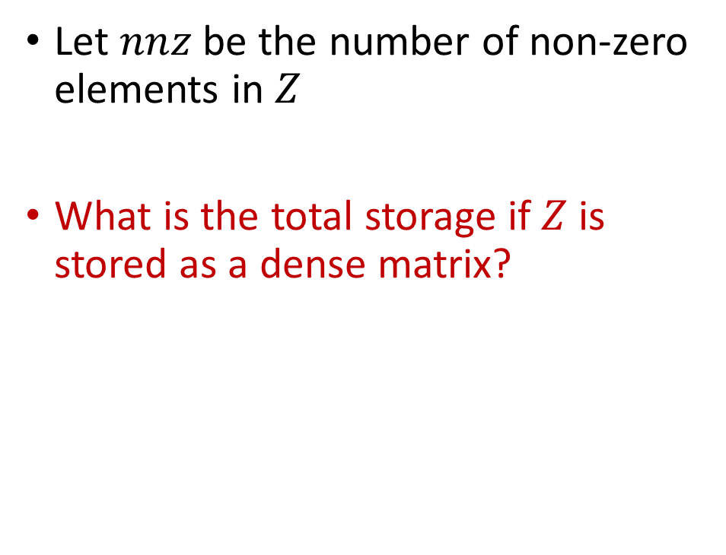
Sparse Dense Matrix Multiplication (SpMM)
$$L$$
$$x_{1}$$
$$x_{2}$$
$$x_{3}$$
$$x_{L}$$
Let $nnz$ be the number of non-zero elements in $Z$
What is the total storage if $Z$ is stored as a dense matrix?
$$x_{1}$$
$$x_{2}$$
$$x_{3}$$
$$L$$
$$x_{L}$$
$$Z$$

Slide 40



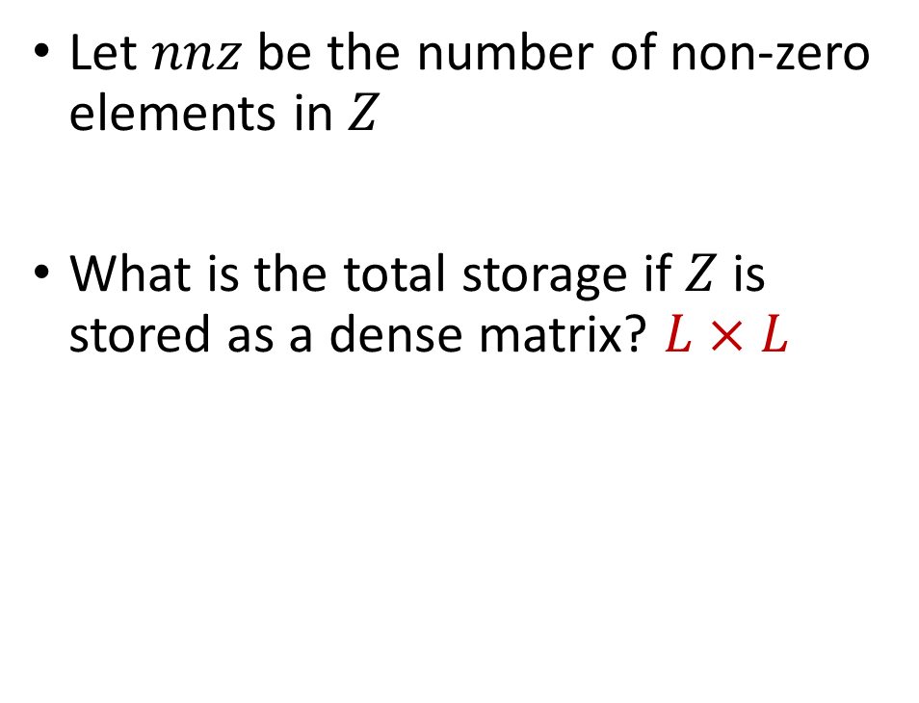




Sparse Dense Matrix Multiplication (SpMM)
$$L$$
$$x_{1}$$
$$x_{2}$$
$$x_{3}$$
$$x_{L}$$
Let $nnz$ be the number of non-zero elements in $Z$
What is the total storage if $Z$ is stored as a dense matrix? $L×L$
$$x_{1}$$
$$x_{2}$$
$$x_{3}$$
$$L$$
$$x_{L}$$
$$Z$$

Slide 41
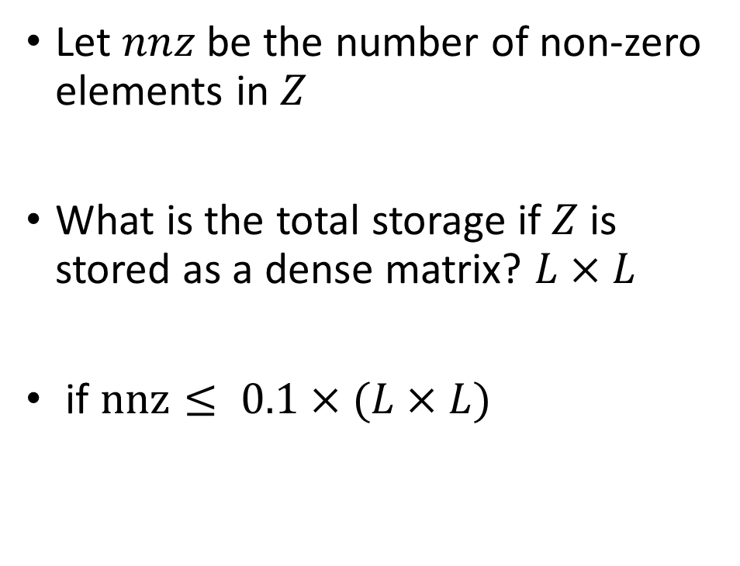
Sparse Dense Matrix Multiplication (SpMM)
$$L$$
$$x_{1}$$
$$x_{2}$$
$$x_{3}$$
$$x_{L}$$
Let $nnz$ be the number of non-zero elements in $Z$
What is the total storage if $Z$ is stored as a dense matrix? $L×L$
if $nnz≤ 0.1×(L×L)$
$$x_{1}$$
$$x_{2}$$
$$x_{3}$$
$$L$$
$$x_{L}$$
$$Z$$

Slide 42
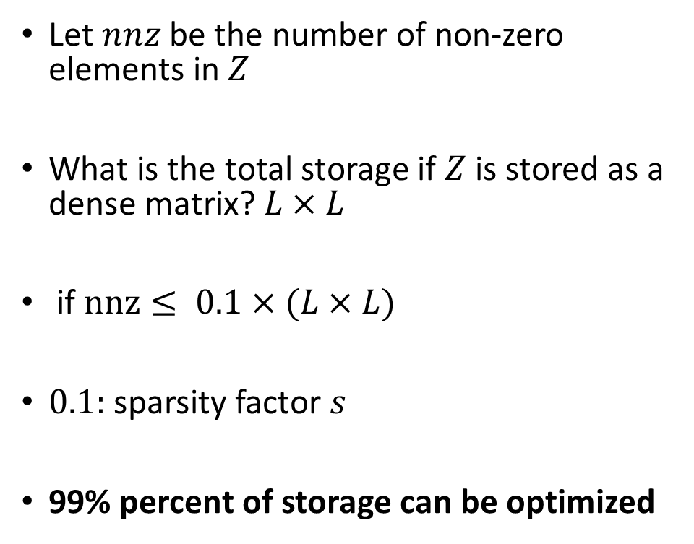
Sparse Dense Matrix Multiplication (SpMM)
$$L$$
$$x_{1}$$
$$x_{2}$$
$$x_{3}$$
$$x_{L}$$
Let $nnz$ be the number of non-zero elements in $Z$
What is the total storage if $Z$ is stored as a dense matrix? $L×L$
if $nnz≤ 0.1×(L×L)$
$0.1:$ sparsity factor $s$
99% percent of storage can be optimized
$$x_{1}$$
$$x_{2}$$
$$x_{3}$$
$$L$$
$$x_{L}$$
$$Z$$

Slide 43
Sparse Dense Matrix Multiplication (SpMM)
Several formats have been proposed with different pros and cons
Suitable for different use cases
https://docs.nvidia.com/cuda/cusparse/index.html#matrix-formats
A few examples
Coordinate (COO)
Compressed Sparse Row/Column (CSR/CSC)
Sliced Ellpack
Block Sparse Row (BSR)

Slide 44





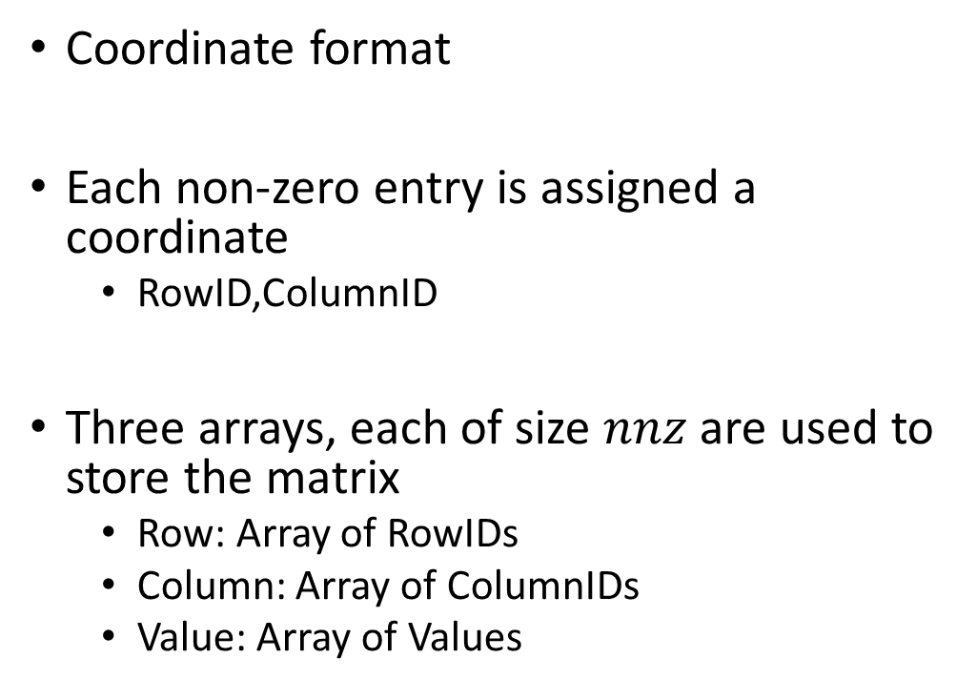






SpMM Storage Format - COO
$$L$$
Coordinate format
Each non-zero entry is assigned a coordinate
RowID,ColumnID
Three arrays, each of size $nnz$ are used to store the matrix
Row: Array of RowIDs
Column: Array of ColumnIDs
Value: Array of Values
$$x_{1}$$
$$x_{2}$$
$$x_{3}$$
$$x_{L}$$
$$x_{1}$$
$$x_{2}$$
$$x_{3}$$
$$L$$
$$x_{L}$$
$$Z$$

Slide 45
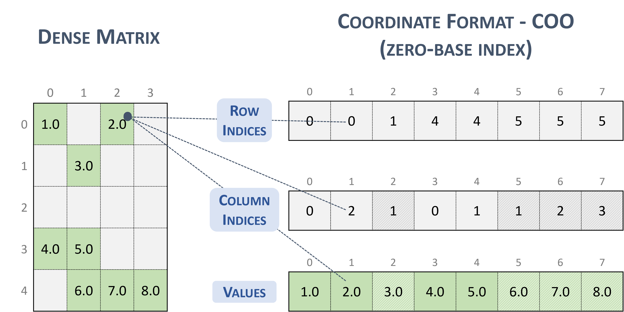
SpMM Storage Format - COO

Slide 46
SpMM Storage Format - COO
Storage requirements?

Slide 47

SpMM Storage Format - COO
Storage requirements? $3nnz$
Each array is of size $nnz$

Slide 48





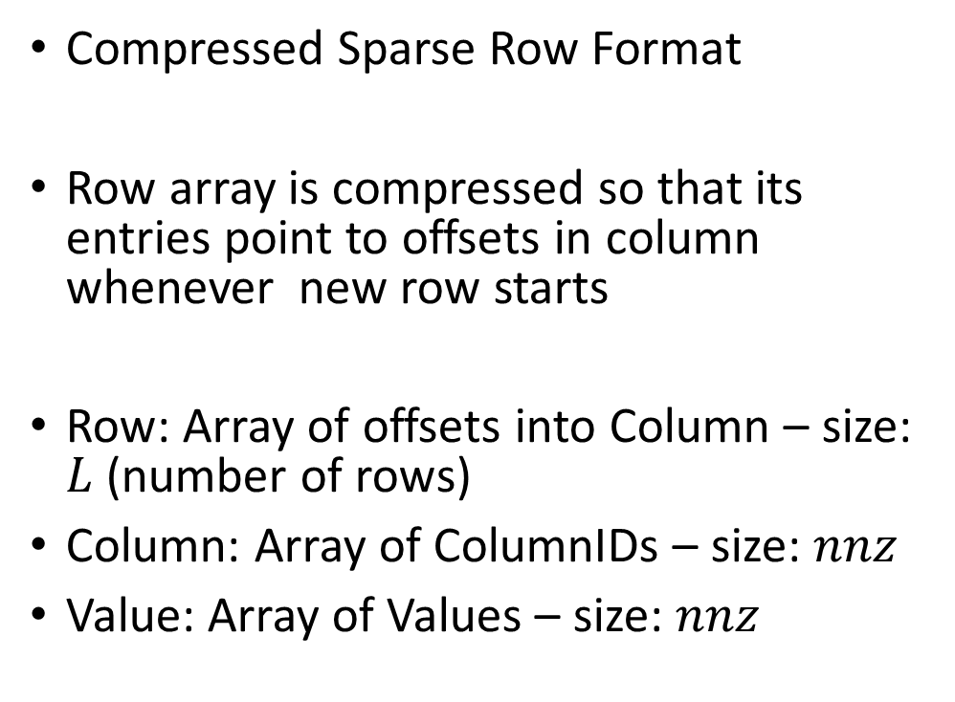






SpMM Storage Format - CSR
$$L$$
Compressed Sparse Row Format
Row array is compressed so that its entries point to offsets in column whenever new row starts
Row: Array of offsets into Column – size: $L$ (number of rows)
Column: Array of ColumnIDs – size: $nnz$
Value: Array of Values – size: $nnz$
$$x_{1}$$
$$x_{2}$$
$$x_{3}$$
$$x_{L}$$
$$x_{1}$$
$$x_{2}$$
$$x_{3}$$
$$L$$
$$x_{L}$$
$$Z$$

Slide 49
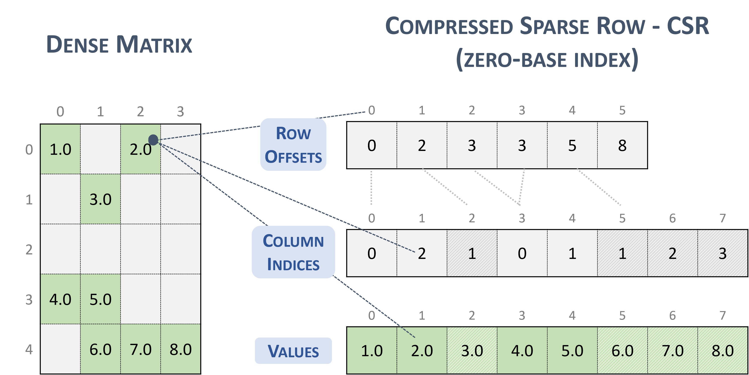
SpMM Storage Format - CSR

Slide 50
SpMM Storage Format - CSR
Storage requirements?

Slide 51
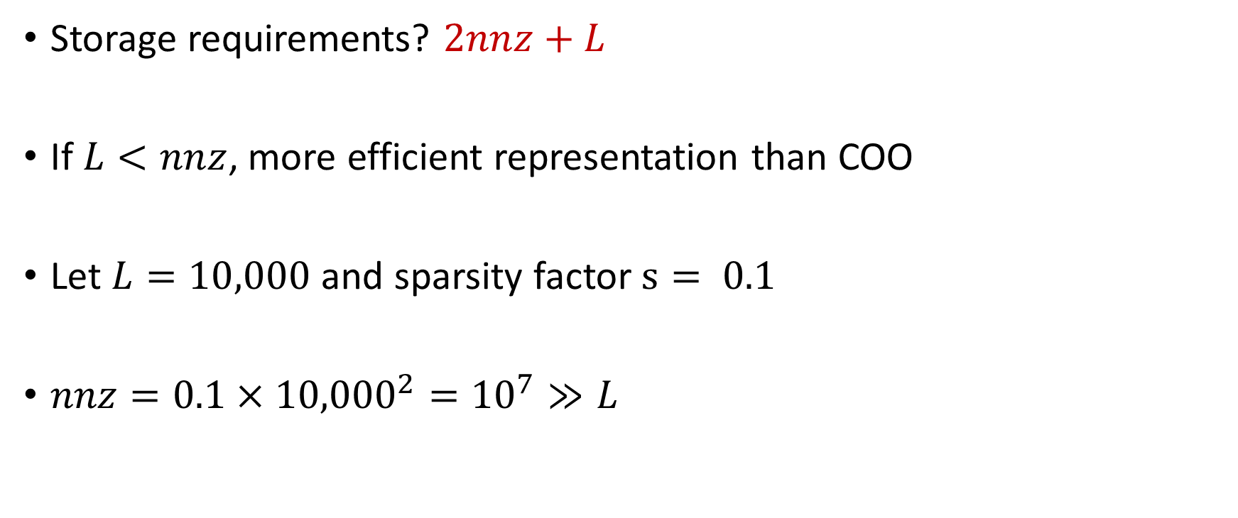
SpMM Storage Format - CSR
Storage requirements? $2nnz+L$
If $L<nnz$, more efficient representation than COO
Let $L=10,000$ and sparsity factor $s= 0.1$
$nnz=0.1×{10,000}^{2}={10}^{7}≫L$

Slide 52
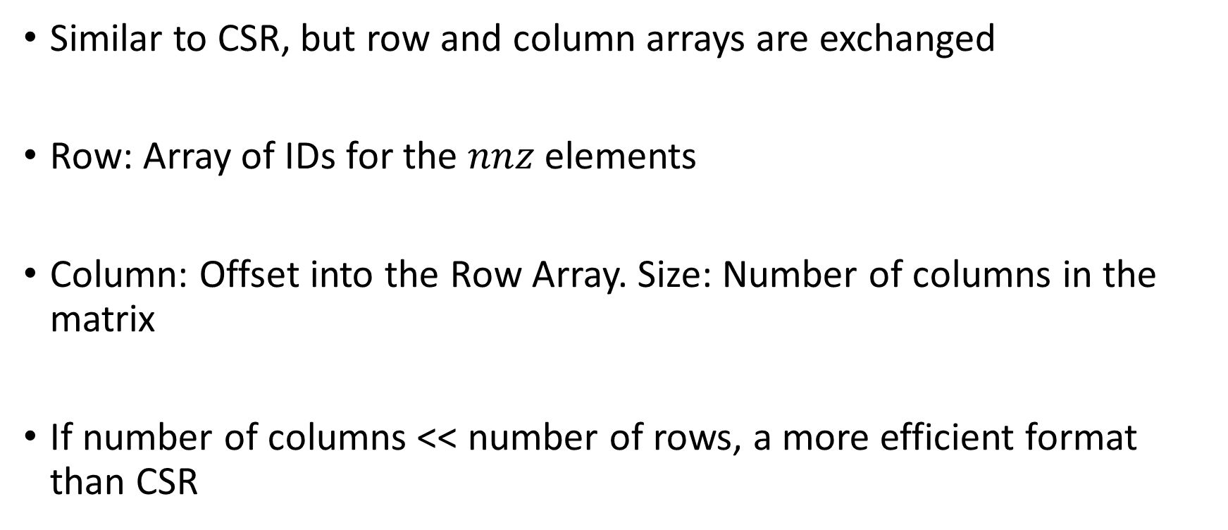
SpMM Storage Format - CSC
Similar to CSR, but row and column arrays are exchanged
Row: Array of IDs for the $nnz$ elements
Column: Offset into the Row Array. Size: Number of columns in the matrix
If number of columns << number of rows, a more efficient format than CSR

Slide 53
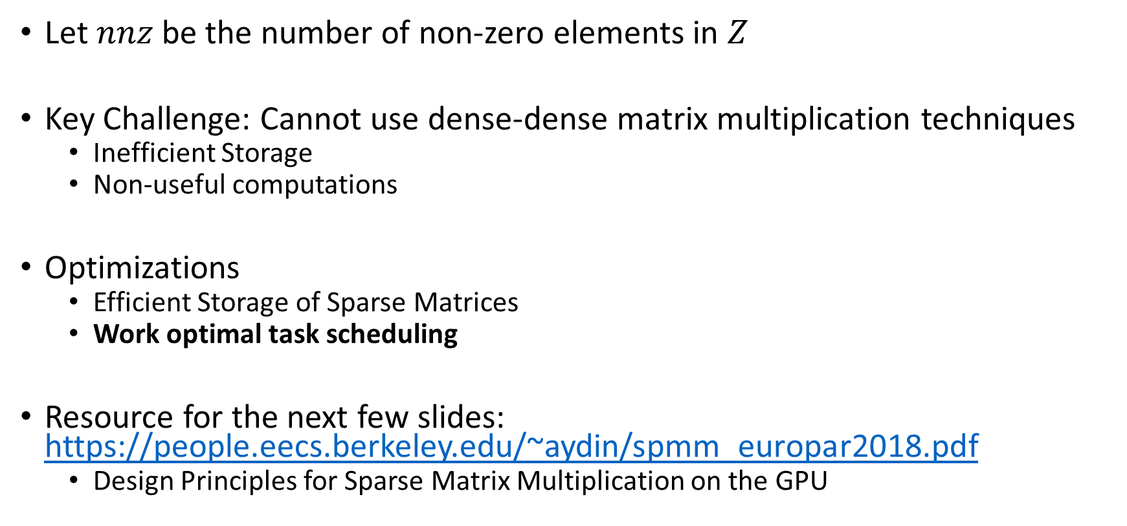
Sparse Dense Matrix Multiplication (SpMM)
Let $nnz$ be the number of non-zero elements in $Z$
Key Challenge: Cannot use dense-dense matrix multiplication techniques
Inefficient Storage
Non-useful computations
Optimizations
Efficient Storage of Sparse Matrices
Work optimal task scheduling
Resource for the next few slides: https://people.eecs.berkeley.edu/~aydin/spmm_europar2018.pdf
Design Principles for Sparse Matrix Multiplication on the GPU

Slide 54
Sparse Dense Matrix Multiplication (SpMM)
Parallelizing SpMM on GPUs
Storage Format: CSR
Recall: GPU Model
How do we assign work to SMPs and Processors within SMPs?

Slide 55






Recall: Modeling GPU Architectures
DRAM
$$0$$
$$1$$
$$S−1$$
C
C
C
0
1
$$p−1$$
0
1
$$p−1$$
0
1
$$p−1$$
$S$ Blocks/SMPs
$p$ Threads/Processors per block

Slide 56
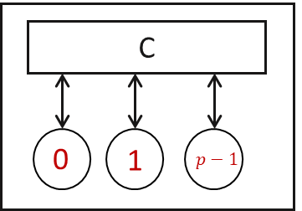
Sparse Dense Matrix Multiplication (SpMM)
Approach #1: Assign each row to a SMP

Slide 57
Sparse Dense Matrix Multiplication (SpMM)
Approach #1: Assign each row to a SMP
Processors execute the non-zero elements of the row.

Slide 58
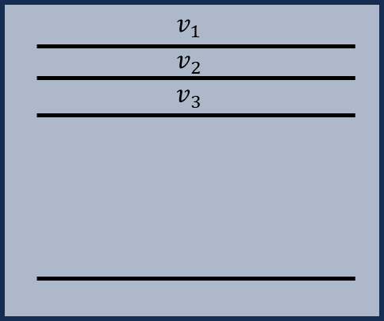
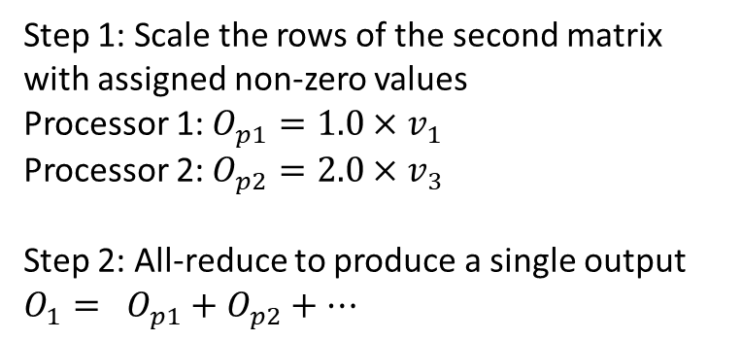
Sparse Dense Matrix Multiplication (SpMM)
Step 1: Scale the rows of the second matrix with assigned non-zero values
Processor 1: $O_{p1}=1.0×v_{1}$
Processor 2: $O_{p2}=2.0×v_{3}$
Step 2: All-reduce to produce a single output $O_{1}= O_{p1}+O_{p2}+…$
Note: Assuming processors are 1 indexed

Slide 59
Sparse Dense Matrix Multiplication (SpMM)
Ungraded HW – may ask in WA 3
Given BlockID, ThreadID, can you write a GPU code for SpMM?
Divide rows evenly among the blocks of GPU
Within each block, divide column indices of rows evenly among the threads
Each thread scales rows that it owns (based on column indices) of the second matrix
Synchthreads
All-reduce of the scaled outputs to produce final output (Recall Parallel Sum? In practice, GPUs have APIs to do this)

Slide 61
Sparse Dense Matrix Multiplication (SpMM)
Approach #1: Assign each row to a SMP
Processors execute the non-zero elements of the row.
Pros: CSR format naturally leads to the assignment
Cons: Load imbalance across SMPs

Slide 62
Sparse Dense Matrix Multiplication (SpMM)
Approach #2: Assign equal number of non-zeros to a SMP

Slide 63
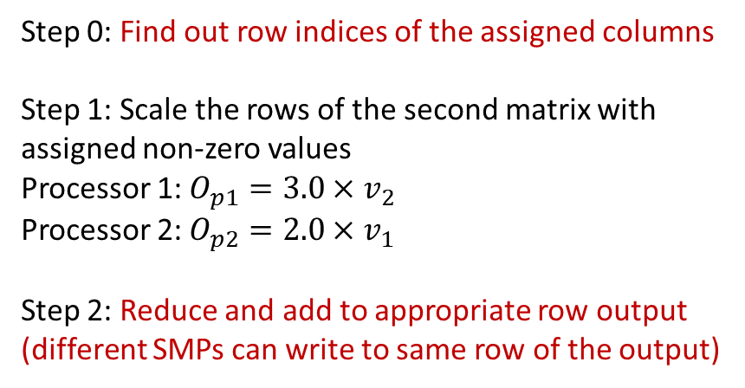
Sparse Dense Matrix Multiplication (SpMM)
Step 0: Find out row indices of the assigned columns
Step 1: Scale the rows of the second matrix with assigned non-zero values
Processor 1: $O_{p1}=3.0×v_{2}$
Processor 2: $O_{p2}=2.0×v_{1}$
Step 2: Reduce and add to appropriate row output (different SMPs can write to same row of the output)
Note: Assuming processors are 1 indexed

Slide 64
Sparse Dense Matrix Multiplication (SpMM)
Given column indices assignment, how can we find the corresponding row indices?
Note: Assuming processors are 1 indexed

Slide 65
Sparse Dense Matrix Multiplication (SpMM)
Given column indices assignment, how can we find the corresponding row indices? Binary Search
Row offset array stores offsets of columns in a sorted manner
For a given column offset, Search it in the row offset array
Since sorted array – Binary search

Slide 66
Sparse Dense Matrix Multiplication (SpMM)
Given column indices assignment, how can we find the corresponding row indices? Binary Search
Row offset array stores offsets of columns in a sorted manner
For a given column offset, Search it in the row offset array
Since sorted array – Binary search
Ungraded HW Assignment: write a GPU code with BlockID and ThreadID. (will not test this approach in the exam)

Slide 67
Sparse Dense Matrix Multiplication (SpMM)
Approach #2: Assign equal number of non-zeros to a SMP
Pros: ??
Cons: ??

Slide 68
Sparse Dense Matrix Multiplication (SpMM)
Approach #2: Assign equal number of non-zeros to a SMP
Pros: Load Balance across SMPs
Cons: (1) Requires a Binary Search Overhead; (2) Requires additional write synchronization across SMPs when a row is split across SMPs

Slide 69
Sparse Dense Matrix Multiplication (SpMM)
Approach #2: Assign equal number of non-zeros to a SMP
Pros: Load Balance across SMPs
Cons: (1) Requires a Binary Search Overhead; (2) Requires additional write synchronization across SMPs when a row is split across SMPs
Split across two processors

Slide 70
Attention with Sparse Attention Mask
Three Key Operations
Operation #1: $Y= QK^{T}| M$: Product of dense matrices under a sparse mask
Operation #2: $Z=Softmax(Y)$
Operation #3: $O=ZV$: Product of $Z$ and $V$ matrices: Product of a sparse and dense matrix
$Q,K^{T}, V$: Dense matrices
$Z$: Sparse matrix

Slide 71
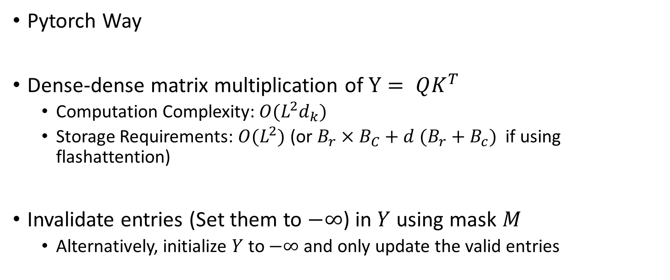
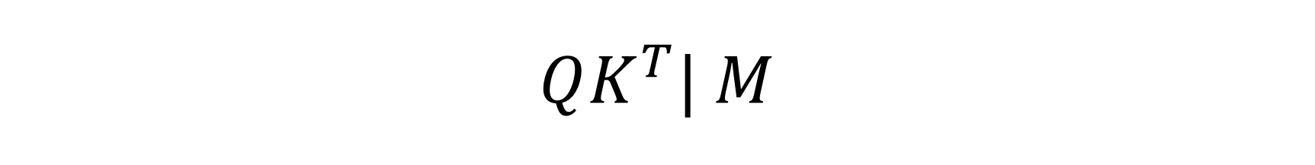
$$QK^{T}| M$$
Pytorch Way
Dense-dense matrix multiplication of $Y= QK^{T}$
Computation Complexity: $O(L^{2}d_{k})$
Storage Requirements: $O(L^{2})$ (or $B_{r}×B_{C}+d (B_{r}+B_{c})$ if using flashattention)
Invalidate entries (Set them to $−∞$) in $Y$ using mask $M$
Alternatively, initialize $Y$ to $−∞$ and only update the valid entries

Slide 72
$$QK^{T}| M$$
Can we directly use SpMM kernel?
No. But similar ideas can be utilized – Sampled Dense Dense Matrix Multiplication
We will discuss in next class

Slide 73
Next Class
11/4 Lecture 19
Accelerating Transformer Model: Sparse Transformers Acceleration II

Slide 74
Thank You
Questions?
Email: sanmukh.kuppannagari@case.edu

